Slide 1
The Transition Academy: Assistive Career Guidance
Team:
Pvga
Members:
Pavan kumar chongala
Syed Usman gani
Vamsi Draksharam
Anusha Konakalla

Slide 2
INTRODUCTION:
The Transition Academy site fills this void by serving as a one-stop shop resource hub that provides an online listing data of colleges, job, employment training and life skills programs based on the location requierments.

Slide 3
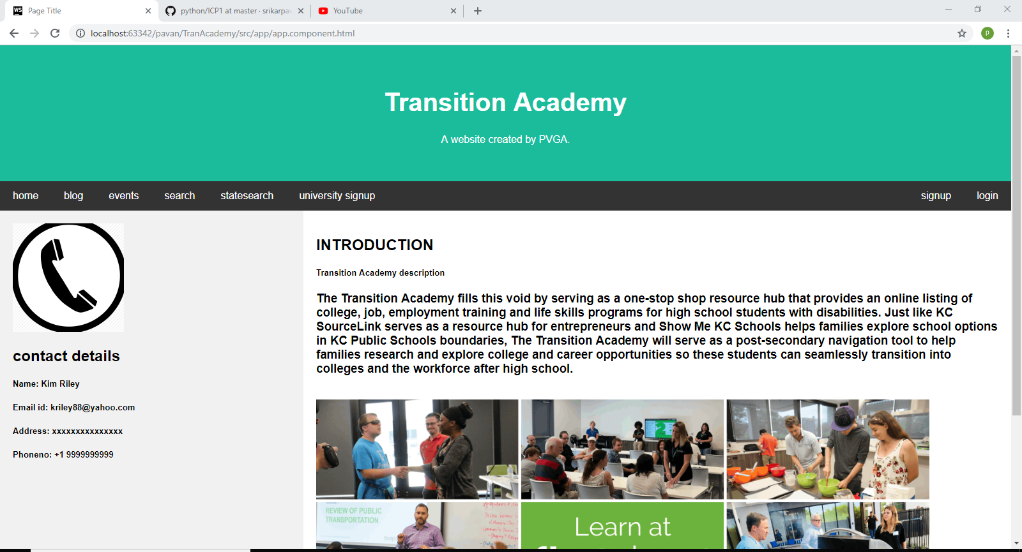

Slide 4

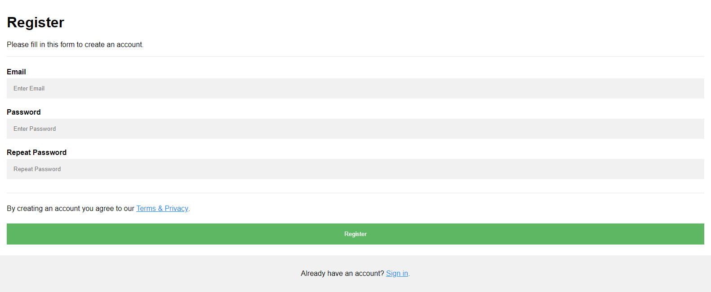

Slide 5
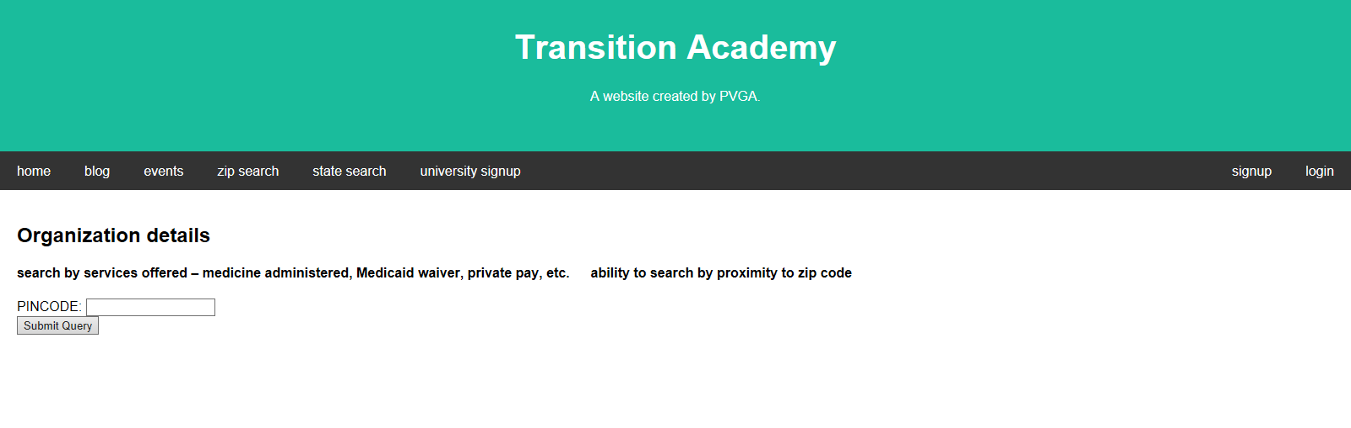
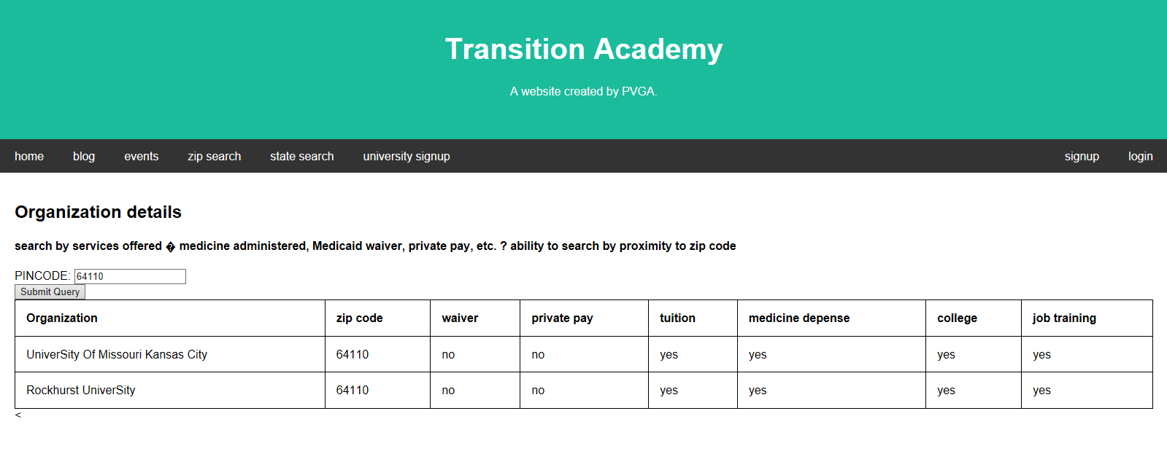

Slide 6
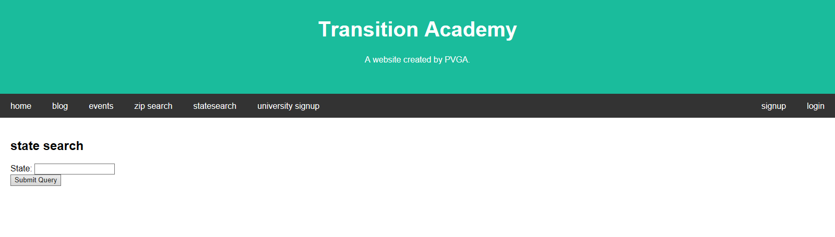
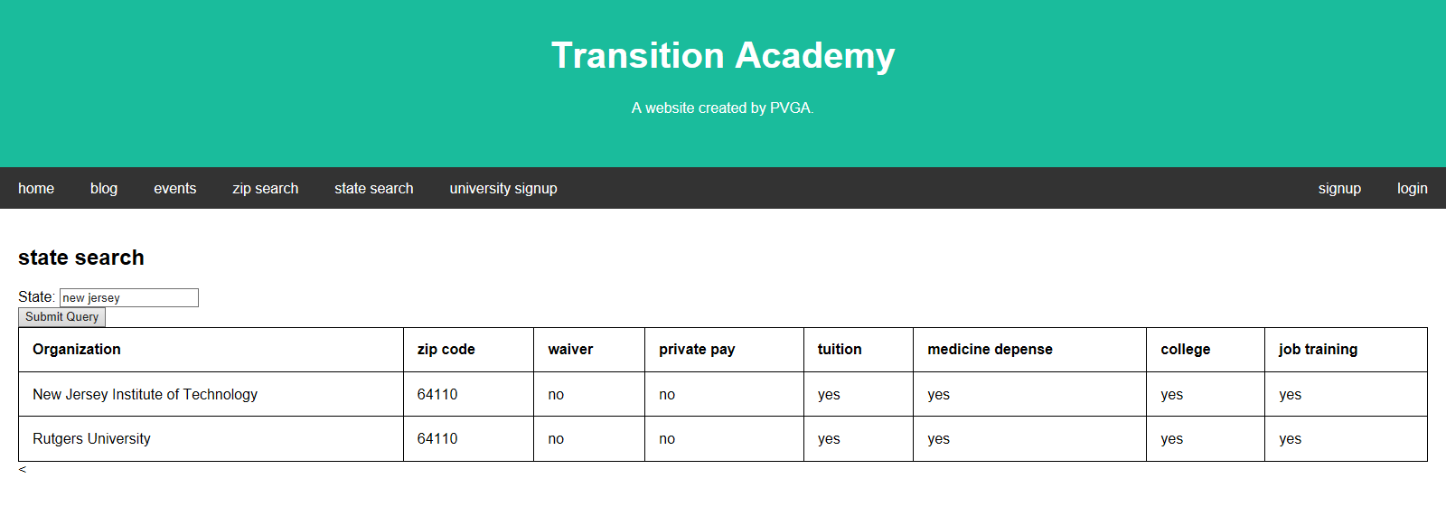

Slide 7


